Slide 1
Prescribing Safety Assessment Training Workshop
Introduction to PSA item authoring
PWS, REV & CAL items
Dr Lynne Bollington

Slide 2
Agenda
PSA item development process
Creating new items

Slide 3
Item development is a multi-stage process
New, V0 (returned VR)
Submit, V1
Edit, V2
PRM, V3
AB & SSG, V4
Use
5 stages of version control (V0–V4)
Only items at V0 & VR can be edited by authors
Items may be returned to VR for revision and resubmission at any stage

Slide 4
Copy editors ensure the items are in house style
New, V0
Submit, V1
Edit, V2
PRM, V3
AB & SSG, V4
Use
information is in the correct order
spelling is corrected
superfluous information is deleted
all abbreviations are from the approved list
reference ranges are consistent with house style
metadata are complete and correct

Slide 5
Clinical reviewer checks item content:
New, V0
Submit, V1
Edit, V2
PRM, V3
AB & SSG, V4
Use
items on correct template
PMH matches DH
indications and doses match BNF
keyed answer matches BNF (if appropriate)
Identify potential problems in item construct
issues are fixed, or flagged for further consideration

Slide 6
Peer review for clinical appropriateness:
New, V0
Submit, V1
Edit, V2
PRM, V3
AB & SSG, V4
Use
reviewers come from various backgrounds and have differing expertise
check face validity
match contemporary practice
unambiguous and clear
appropriate difficulty
relevant to FY1

Slide 7
Assessment Board approves paper(s); Standard Setting Group set pass mark:
New, V0
Submit, V1
Edit, V2
PRM, V3
AB & SSG, V4
Use
Assessment Board:
approves paper build, including item anchoring, re-use etc
checks against assessment blueprint
confirms coverage of therapeutic domains and topics
checks item content
elaborates on mark schemes
reviews item usage post-hoc
SSG:
checks item content
considers difficulty of items
sets pass mark/item

Slide 8
Item progress can be viewed by the author in the Dashboard Feedback is visible at all stages
VR
V1
V2
V3
V4
V0
DD

Slide 9
Agenda
PSA item development process
Creating new items

Slide 10
Adding new item
Side menu expands to show text

Slide 11
Prescribing items (PWS)
PWS items present a scenario where a prescription is required
Reasoning and judgement Deciding on the most appropriate prescription to write, based on the clinical circumstances
Measurable action Writing a safe, effective prescription for a single medicine to tackle a specific indication or syndrome.

Slide 12
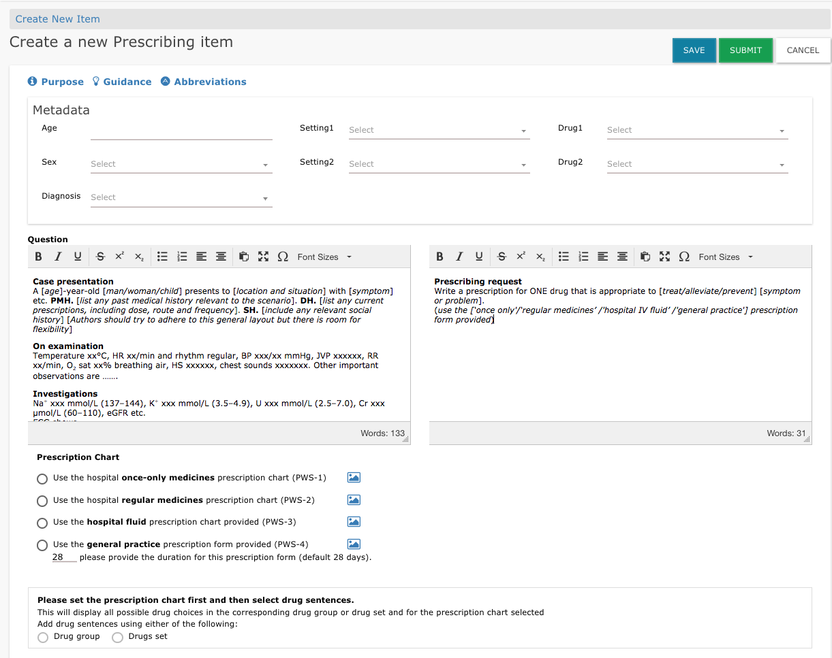
Starting a new item

Slide 13
Select a prescription chart

Slide 14
Write a case presentation

Slide 15
Edit the prescribing request as appropriate

Slide 16
Suggest a marking scheme

Slide 17
Or select a drug set (if available)

Slide 18
Use the British National Formulary, to which the candidates will have access throughout, as the ultimate arbiter of dose ranges, routes, indications, contra-indications, etc.

Slide 19
Include justifications for optimal and suboptimal answers
Remember to save the mark scheme after adding each drug.

Slide 20
For IV fluids, indicate which volumes and which rates are acceptable

Slide 21
System navigation help tools
In viewing mode:
In edit mode:
edit
delete
copy

Slide 22
Item usage and performance data

Slide 23
This item was insufficiently focused
New, V0
Submit, V1
Edit, V2
PRM, V3
AB & SSG, V4
Use
Fac: 98.6%
Dis: 0.084

Slide 24
. . there were too many correct answers
New, V0
Submit, V1
Edit, V2
PRM, V3
AB & SSG, V4
Use
Fac 98.6%
Dis: 0.084

Slide 25
Prescription Review items (REV)
REV items present a prescription for review, that was written by someone else
Reasoning and judgement Deciding which components of the prescription are inappropriate, unsafe or ineffective

Slide 26
Identifying ADRs, interactions, contraindications and dose errors
Only ONE dose error permitted - more than one is very unlikely in practice

Slide 27
Two questions, with 1-3 marks each (max 4 marks in total)
If one of the questions is an interaction, include ONE of the interacting drugs in the case presentation and lead-in so candidates don’t have to pick both drugs from the list of medicines.

Slide 28
House style is important here
List between 6–10 medicines
lower case,
generic name,
no strength
Select from drop-down lists that appear when you begin to type

Slide 29
Calculation skill items (CAL)
Competencies
Reasoning and judgement Making an accurate drug calculation based on numerical information
Measurable action Recording the answer accurately with appropriate units of measurement

Slide 30
All facts required to do the calculation must be included

Slide 31
This item was too easy and did not discriminate
New, V0
Submit, V1
Edit, V2
PRM, V3
AB & SSG, V4
Use
Fac: 98.0%
Dis: 0.055
Complex, multi-step calculations tend to work best

