Slide 1
Prescribing Safety Assessment Background, purpose and structure
Professor Simon Maxwell, PSA Medical Director
Notes:
1

Slide 2
Background

Slide 3
Prescribing medicines
the most common intervention (for good or bad) that most doctors make to improve the health of their patients

Slide 4
Concerns about FY1 Prescribing
Illing et al (2008)
How prepared are medical graduates to begin practice? A comparison of three diverse UK medical schools.
Prescribing considered to be the key problem
Over 80% graduates failed a prescribing assessment
Skills for Health Report (2009)
Junior doctors in the NHS: Preparing medical students for employment and post-graduate training
65% of respondents considered prescribing was an issue
EQUIP Study (2009)
An in depth investigation into causes of prescribing errors by foundation trainees in relation to their medical education.
125,000 prescriptions in North-West England – error rate 9%
PROTECT Study (2011)
45,000 prescriptions in Scotland – error rate 7%

Slide 5
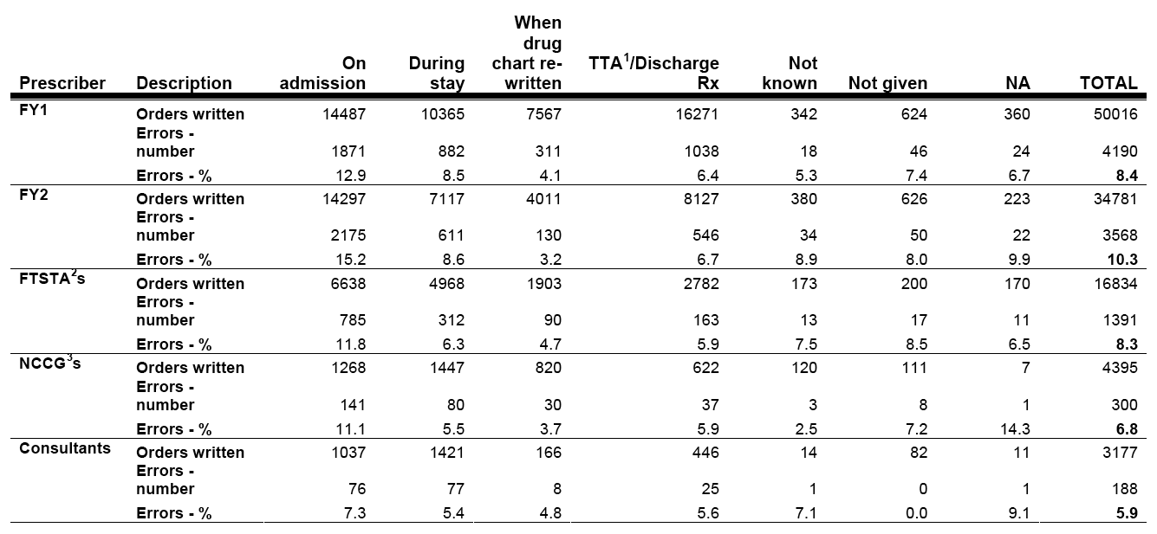
An in depth investigation into causes of prescribing errors by foundation trainees in relation to their medical education. EQUIP study. Dornan et al, 2009
124,260 medication orders
Available at http://www.gmc-uk.org/about/research/research_commissioned_4.asp
Notes:
What is the scale of the problem?
124,260 medication orders were checked
11,077 errors were detected
Across all grades/types of prescriber, the mean rate of prescribing errors was 8.9% of medication orders
50,016 medication orders were written by FY1 doctors
4190 errors were detected on FY1 medication orders
The rate of prescribing errors for FY1 doctors was 8.4%
System-based and person-based
Report suggested five main targets for interventions to improve patient safety by minimising prescribing errors:
Clinical working environments
Undergraduate medical education programmes
Foundation Year 1 education
Other parts of the medical education continuum
Interprofessional education
5

Slide 6
Safe Prescribing Working Group (2008)
Clearly defined learning outcomes related to prescribing medicines
A national e-Learning strategy to support students in reaching these outcomes
A reliable assessment to enable students/schools can demonstrate that these learning outcomes have been met
Unified prescription charts
Improved training and access to the BNF
Notes:
Competencies Required on Day 1 of FY1
Based on the current activities and levels of supervision possible in typical NHS secondary care facilities, we believe that the following competencies are necessary for FY1 doctors:
The ability to establish an accurate drug history This may be taken directly from the patient, from a collection of medicines, or from information given by others (carers, GP, old prescriptions). The record of this history should include making relevant conclusions from past exposures, including effective interventions and unsuccessful or harmful ones (drug allergies, adverse drug reactions, and drug interactions).
The ability to plan appropriate therapy for common indications This means deducing appropriate treatment, based on symptoms, signs, and investigations. Such treatment might be preventive, curative, symptomatic, or palliative. It should be possible to plan treatment that is appropriate to individual patients. This will involve deciding at a simple level between options that might include different drugs, different formulations, different routes, different doses, and different durations. It should be possible to plan treatment for common acute and chronic conditions, including the use of high-risk drugs (e.g. anticoagulants, opioids, insulin).
The ability to write a safe and legal prescription This will usually be on a hospital drug administration chart (once-only, regular, and as required medications), but may include other relevant documentation (e.g. an infusion chart, insulin chart, warfarin chart, oxygen chart, TTO prescriptions). This skill would also include cancelling prescriptions and understanding other aspects of documentation. Prescriptions would be expected to meet appropriate standards, being legible, unambiguous, and complete (approved name written in upper case, appropriate form and route, correct dose appropriately written without abbreviations, necessary details and instructions, signed). It should be possible to prescribe controlled drugs. This skill would normally be undertaken with access to a copy of the British National Formulary.
The ability to appraise critically the prescribing of others This will include the ability to review prescription charts and relate medicines to symptoms (e.g. a nitrate and headache), identify common drug interactions (e.g. erythromycin with warfarin), identify inappropriate prescriptions (e.g. a hypnotic during daytime), and identify obvious dosing errors for common drugs (e.g. aspirin).
The ability to calculate appropriate doses These might include simple dosage calculations by weight or body surface area and adjustments for age or renal function. This will include knowledge of different expressions of drug doses.
The ability to provide patients with appropriate information about their medicines This will include being able to provide important information about commonly used drugs or groups of drugs (~75 in all, see Appendix), being able to help patients make informed decisions about their care, and being able to give instructions that improve safety and effectiveness (e.g. safety warnings about warfarin, explanations about inhaled therapy).
The ability to access reliable information about medicines This might include standard hard-copy references, such as the BNF and the Datasheet/SPC compendium, but will increasingly involve an electronic search. This would involve being able to check for contraindications, drug-drug interactions, and known adverse drug reactions.
The ability to detect and report adverse drug reactions This should include recognition of specific types of drug-induced disease, such as anaphylaxis, maculopapular rash, bone marrow suppression, liver disorders, kidney disease. It should also include the ability to report an adverse drug reaction and awareness of sources of information on adverse drug reactions.

Slide 7
Those competencies (and more) included in Outcomes for graduates 2018 (based on Tomorrow’s Doctors 2009)

Slide 8
Purpose

Slide 9
Why a national prescribing assessment?
Clinical governance/patient safety reasons
Educational reasons
No other validated, reliable and widely accepted measure of prescribing performance currently exists
A national prescribing assessment:
pools academic resources
serves to raise and unify standards (drive learning)
provides equity in assessment
allows us to measure educational success
Notes:
Clinical governance/patient safety reasons
Prescribing is a fundamental skill of a doctor
Assessment is a marker of competence to enter into (or continue in) clinical practice
Protection of patients – patient safety
Educational reasons
Measure the success of training
Identify the need for improvements in training
Contribution to training (formative assessment)
Foster higher standards of attainment in prescribing

Slide 10
Prescribing Safety Assessment
Developed jointly by MSC Assessment and British Pharmacological Society since 2010
Supported by input of other stakeholders such as GMC, NHS employers, Foundation programme, BMA medical students, Postgraduate Deans

Slide 11
PSA: Basic principles
Should be passed before qualification and subsequent assumption of NHS prescribing responsibilities
Designed for final year medical students
Pass-fail assessment that can be repeated if necessary
Delivered online from a central server
‘Open book’ with access to the British National Formulary
Assesses prescribing-related skills relevant to new doctors that map onto those in Outcomes for graduates 2015
Tests skills and deductive powers (as well as knowledge)
Set at the level of early postgraduate practice
Notes:
The PSA is intended to assess basic competence in relation to:
core knowledge about common medicines
basic problem-solving skills related to medicines
judicious selection and prescription of common medicines
treatment of common clinical conditions
management of common medical emergencies
review of prescriptions made by other clinicians
calculation skills
The PSA is not meant to assess:
the ability to investigate or diagnose medical conditions

Slide 12
Development

Slide 13
PSA Governance
MSC Assessment
British Pharmacological Society
GMC
Postgraduate Deans
MSC-Assessment Alliance
BMA Medical Students Committee
NHS Employers
Prescribing Safety Assessment Project Team is responsible for delivering the key work streams
PSA Executive
Assessment
Board
Stakeholder
Group
Technical
Group
Project Team
Work
Stream 1
ITEM BANK
Work
Stream 2
DELIVERY
Work
Stream 3
GUIDANCE
Notes:
The Prescribing Skills Assessment (PSA) is being developed by a Steering Group, led by the British Pharmacological Society and the Medical Schools Council. The Steering Group includes representation from key stakeholder groups including medical students and the General Medical Council, and is responsible for taking strategic decisions about the development and implementation of the PSA. The Steering Group is supported by the Prescribing Skills Assessment Project Team which is responsible for delivering the key workstreams involved in developing the PSA. The project has received initial funding from the Department of Health to support the development and piloting of the assessment.

Slide 14
Funding sources
The PSA has received funding from:
British Pharmacological Society
MSC Assessment
Department of Health
NHS Education Scotland
Health Education England
Notes:
The Prescribing Skills Assessment (PSA) is being developed by a Steering Group, led by the British Pharmacological Society and the Medical Schools Council. The Steering Group includes representation from key stakeholder groups including medical students and the General Medical Council, and is responsible for taking strategic decisions about the development and implementation of the PSA. The Steering Group is supported by the Prescribing Skills Assessment Project Team which is responsible for delivering the key workstreams involved in developing the PSA. The project has received initial funding from the Department of Health to support the development and piloting of the assessment.

Slide 15
Structure

Slide 16
Prescribing Safety Assessment
MED
SURG
ELD
PED
PSYCH
O&G
GP
Section 1
Prescribing
Section 8
Data
Interpretation
Section 2
Prescription
Review
Section 7
Drug
Monitoring
8 sections – 60 items
TOTAL = 120 mins
(200 marks)
Section 3
Planning
Management
Section 6
Adverse Drug
Reactions
Section 4
Providing
Information
Section 5
Calculation
Skills

Slide 17
Prescribing Safety Assessment – Format
Style | Item Content | Marks
Prescribing | 8 items of 10 marks | 80
Prescription Review | 8 items of 4 marks each | 32
Planning Management | 8 items of 2 marks each | 16
Providing Information | 6 items of 2 marks each | 12
Calculation Skills | 8 items of 2 marks each | 16
Adverse Drug Reactions | 8 items of 2 marks each | 16
Drug Monitoring | 8 items of 2 marks each | 16
Data Interpretation | 6 items of 2 marks each | 12
TOTALS | 60 | 200

Slide 18
Prescribing Safety Assessment
Additional construction rules
Coverage of clinical settings
Minimum number of items
Medicine – 8
Surgery – 4
Elderly care – 8
Paediatrics – 4
Psychiatry – 4
Obstetrics & Gynaecol. – 4
General practice – 8
Coverage of high risk drugs
At least one item on
Opiates
Anticoagulants
Insulin
Antibiotics
Infusion fluids
Notes:
Each PSA will include at least one item on opiates, anticoagulants, insulin, antibiotics, and infusion fluids. These drug Groups Were Selected On The Basis That They Were Included In The List Of 8 High Risk Prescribing Categories Identified By The NPSA As Being Most Commonly Associated With Severe Harm Or death.1 Drugs In The Other 3 Categories (anaesthetics, Chemotherapy And Antipsychotics) Were Omitted On The Basis That Foundation Doctors Would Not Routinely Have responsibility For Prescribing These agents.

Slide 19
Progress

Slide 20
PSA Progress
 | Item development activity |  | Test delivery activity
Acad. year | No of active PSA authors | No. of peer-reviewed items in bank | Med schools | Candidates | Comment
2010-11 | 0 | 0 | 2 | 200 | Online pilot (30 items)
2011-12 | 60 | 600 | 8 | 1300 | Online pilot (30 items)
2012-13 | $\sim$40 | 1200 | 29 | 5000 | Online pilot (60 items)
2013-14 | 27 | 1500 | 31 | 8000 | Implementation + O’seas schools
2014-15 | 46 | 1850 | 31 | 8000+ | Implementation + O’seas, FYP & NMPs
2015-16 | 92 | 2130 | 31 | 8000+ | GMC statement re PSA & working in NHS
2016-17 | 100+ | 2500 | 31 | 8000+
Notes:
Annual cycle of author training, item commissioning and peer review.
No author training in 2012 or 2013.
Momentum has been regained, and numbers of authors and items are increasing rapidly.
1 paper, 30 items
1 paper, 30 items
2 papers, 60 items
5 papers, 60 items
4 papers 60 items
4 papers 60 items
5 papers, mock & practice papers

Slide 21
PSA2015: Student feedback
Q1 | This assessment was an appropriate test of the prescribing skills of a medical student upon graduation | 3.46
Q2 | My course prepared me for the content of the questions in this assessment | 2.99
Q4 | The time provided for answering the questions was sufficient | 2.41
Q5 | The layout and presentation of the questions was easy to follow | 3.88
Q6 | The online interface was easy to use | 3.90
Q7 | The information (available prior to the event on prescribing-safetyassessment.ac.uk) about the PSA was useful | 3.90
Q8 | The questions in the assessment were clear and unambiguous. | 3.51
Strongly agree = 5, agree = 4, neural = 3, disagree = 2, strongly disagree = 1

Slide 22
PSA2015: Student feedback
Q3. The number of prescriptions that I have written on a prescription chart during my training is
0 – 5 | 25%
6 – 10 | 19%
11 – 20 | 24%
21 – 50 | 23%
More than 50 | 9%

Slide 23
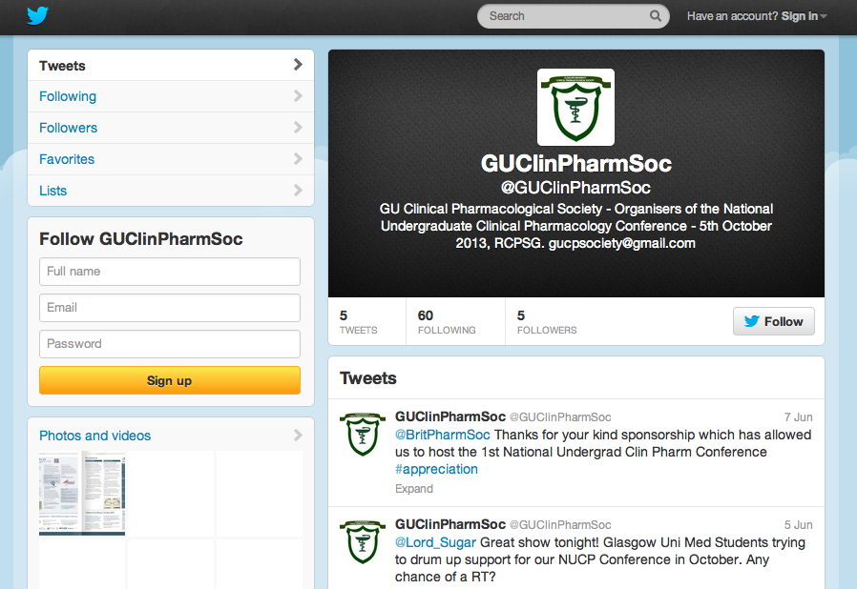
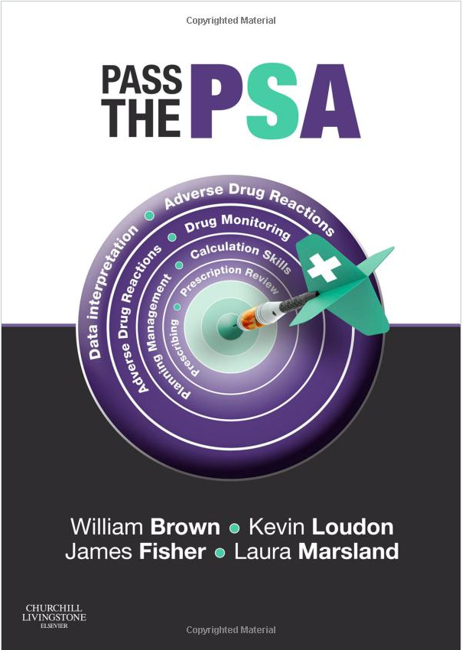
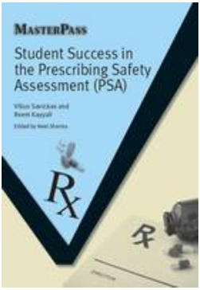

Slide 24
Summary
Prescribing is a key clinical skill for all doctors
There is evidence of poor prescribing practice amongst new graduates and others
A reliable and valid assessment of competence is helpful for medical schools and the NHS, and serve to stimulate improved educational experiences for students
The Prescribing Safety Assessment enables graduates to demonstrate that they have achieved a basic level of competence

Slide 25
Prescribing Safety Assessment Quality control, peer review and delivery
Professor Simon Maxwell, PSA Medical Director
Notes:
25

Slide 26
Work streams
Question item bank development
Online delivery platform
Guidance and communications

Slide 27
Quality control

Slide 28
Item Bank and Test Development
Now have over 100 trained authors
Question item authors have diverse backgrounds
Medical Schools
British Pharmacological Society
Clinical pharmacy
Items submitted to PSA online system
Notes:
Volunteer item writers including clinical pharmacologists and pharmacists and others with relevant expertise in prescribing write the items for inclusion in the item writing bank. Assessment items undergo a process of quality assurance/ peer review which involves an Assessment Board, responsible for assembling and standard setting each assessment paper.

Slide 29
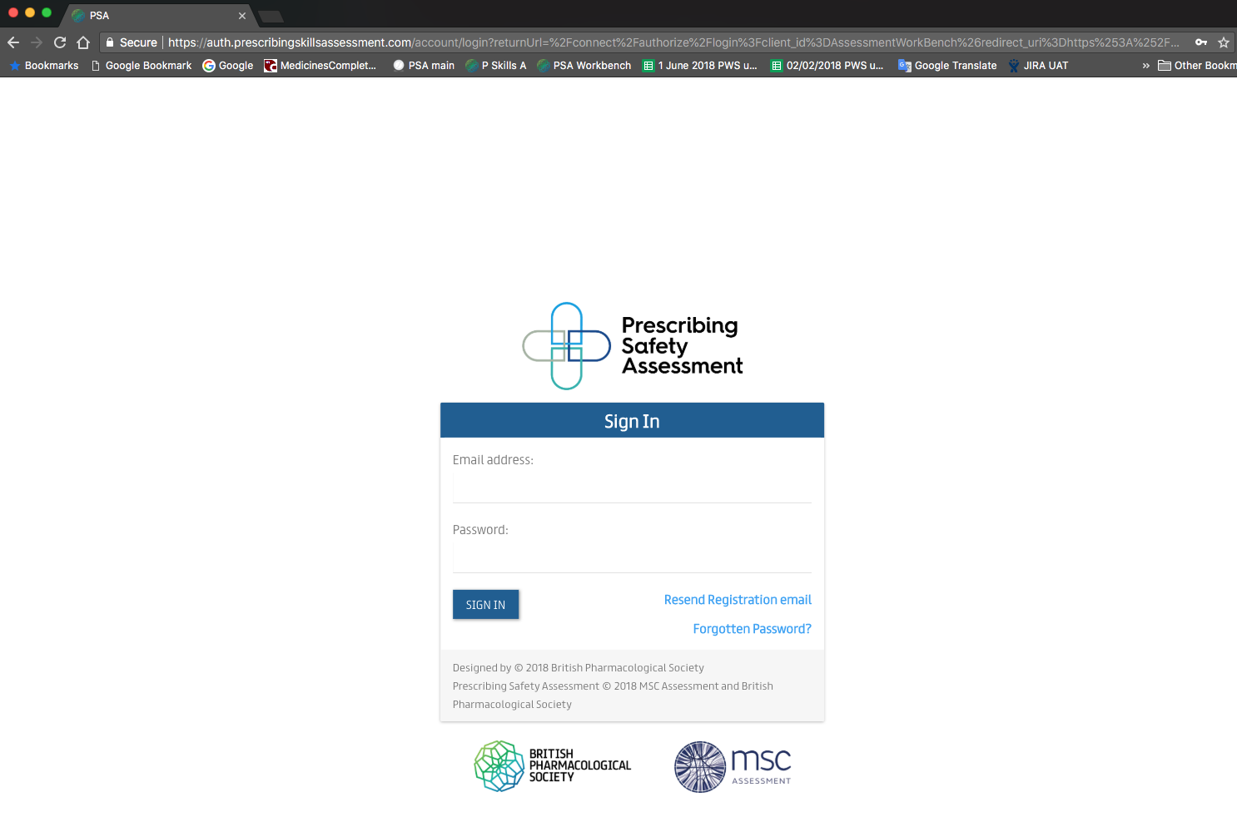
Authoring
Editing
Quality assurance
Item bank
Assessment construction
Assessment events
Psychometric analysis
Drug bank

Slide 30
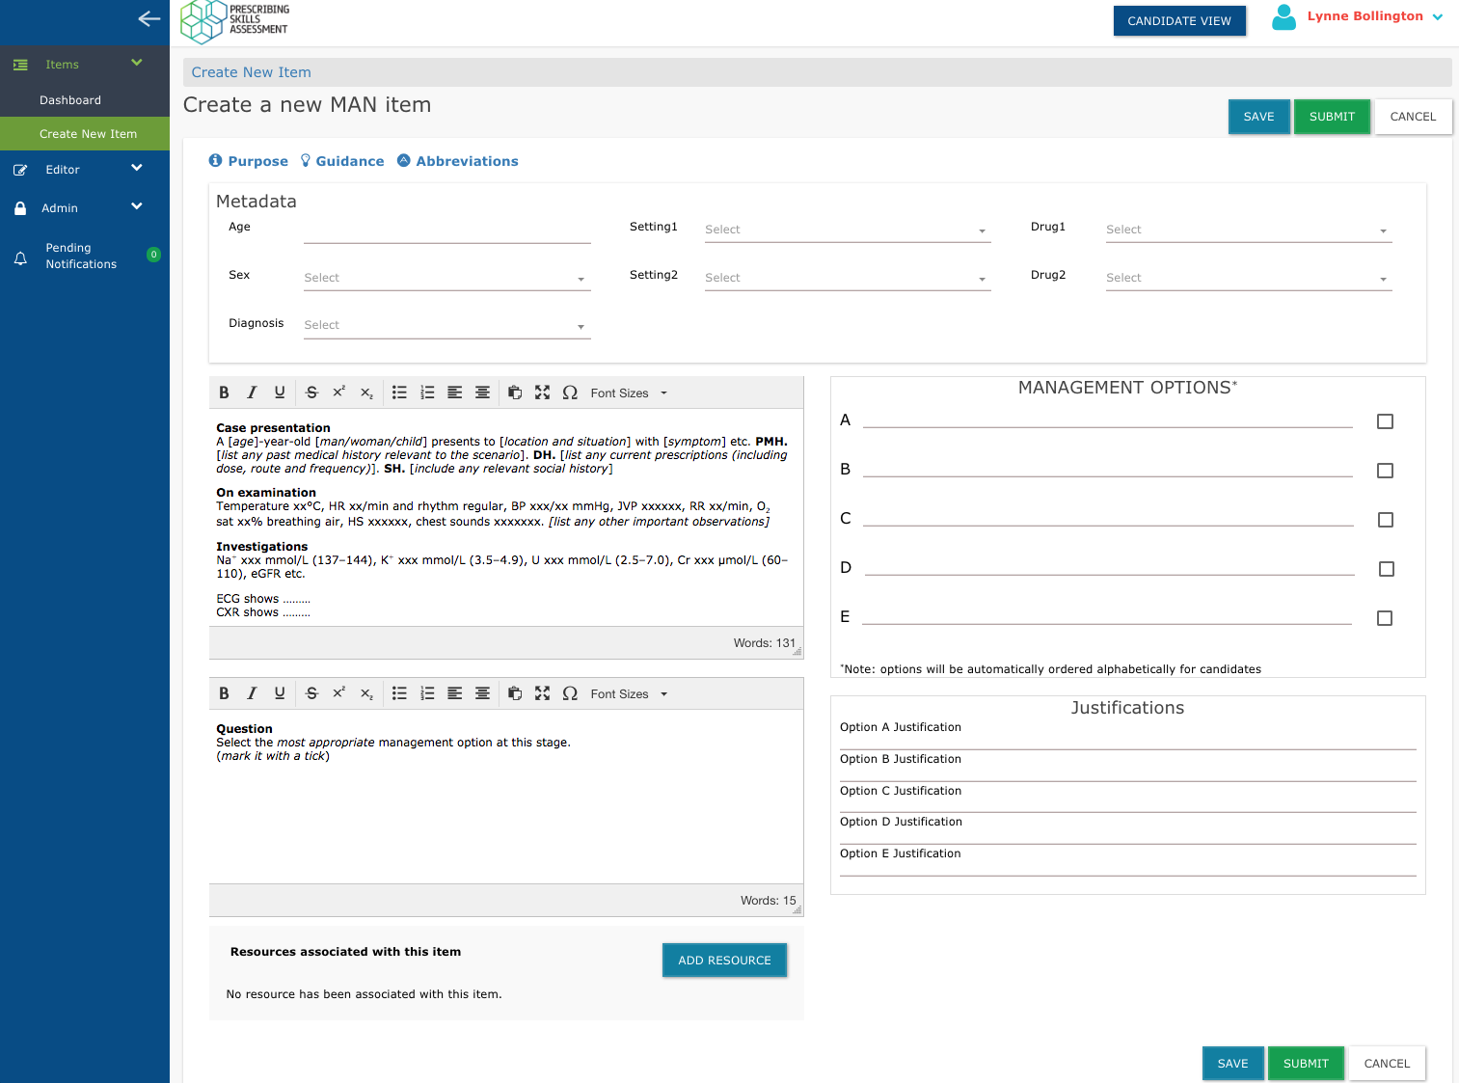

Slide 31
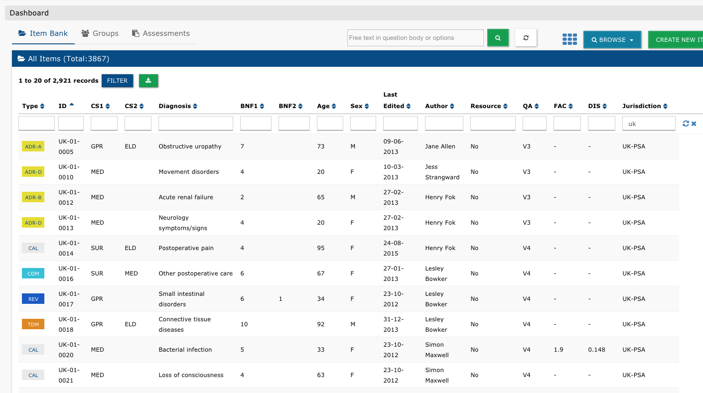
May 18~ 3300 items

Slide 32
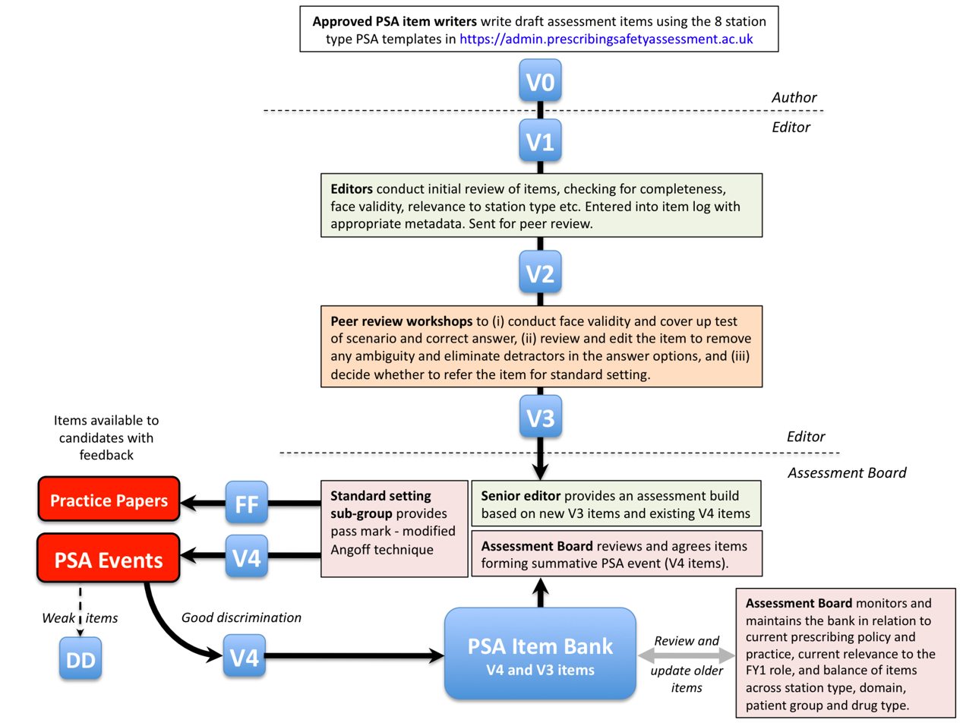

Slide 33
Item development cycle
Items commissioned from trained authors (Sept–Dec)
Peer review event over 2 days in Birmingham (May)
PSA question papers constructed (September)
Assessment Board meeting (November)
Standard Setting meeting (January)
PSA events in medical schools (Feb–June)

Slide 34
Delivery

Slide 35
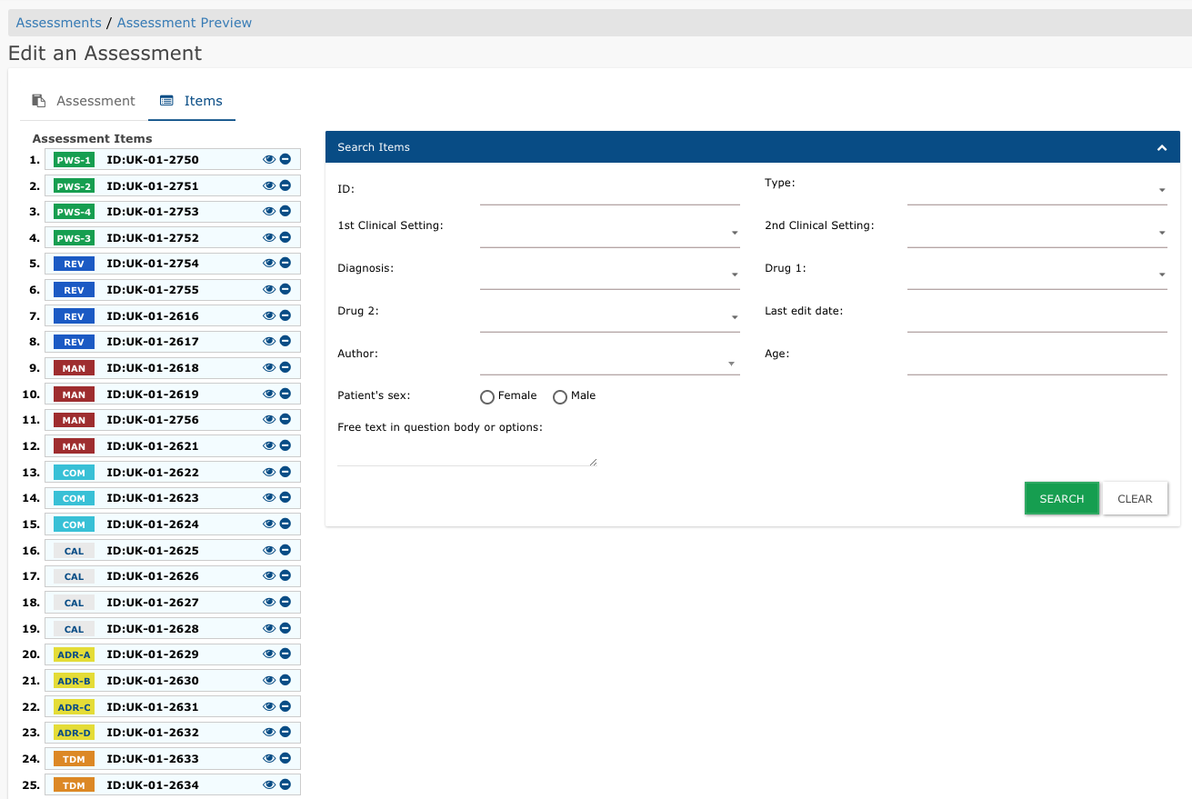

Slide 36
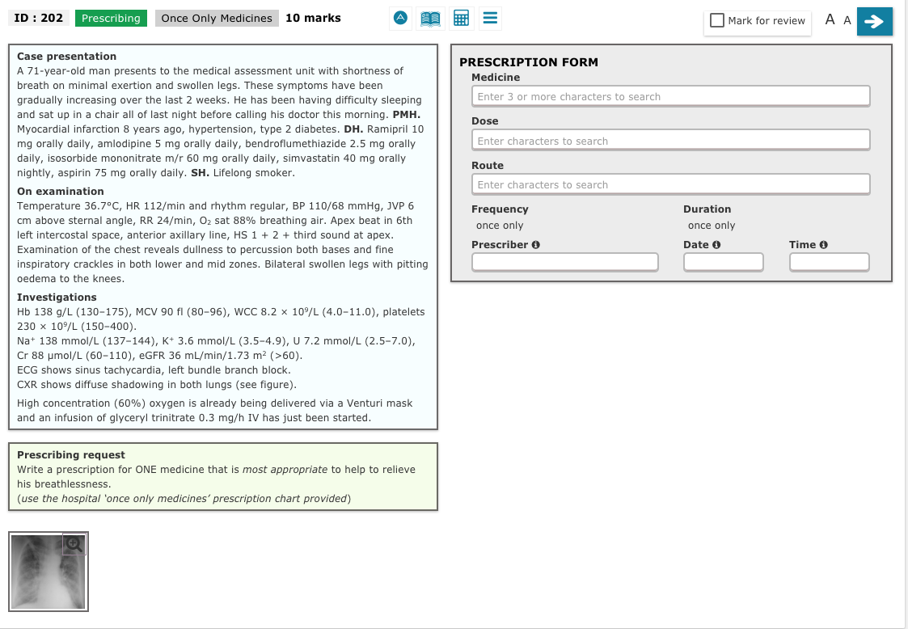
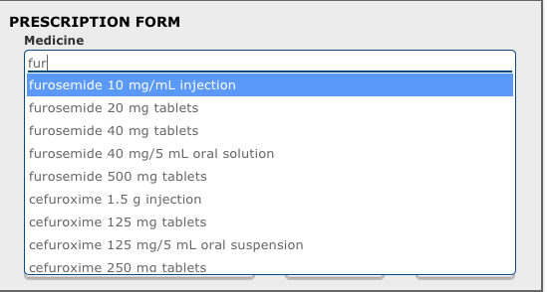
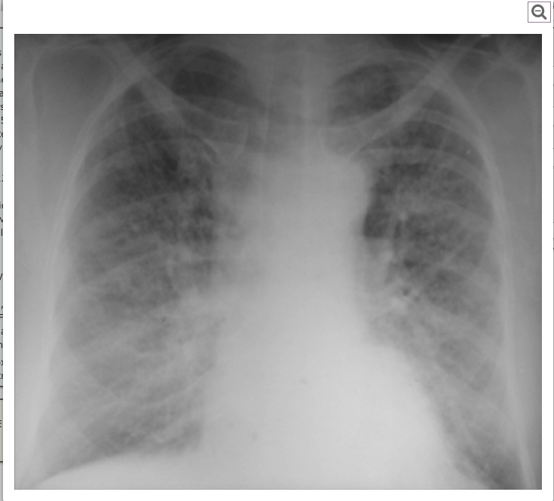

Slide 37
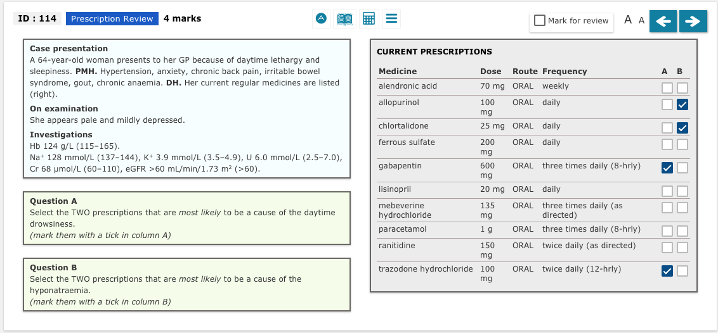

Slide 38
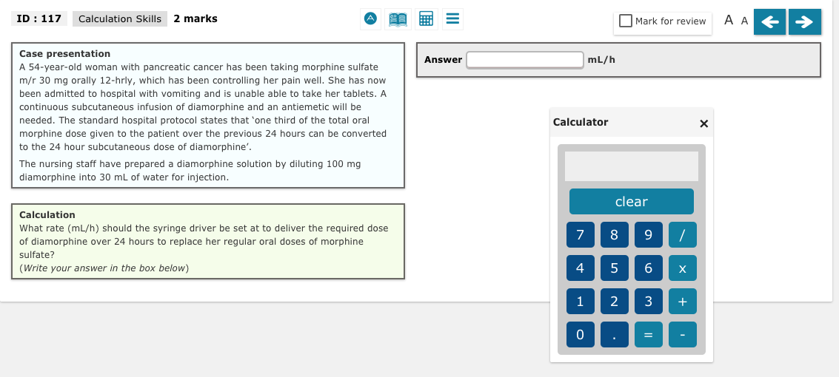

Slide 39
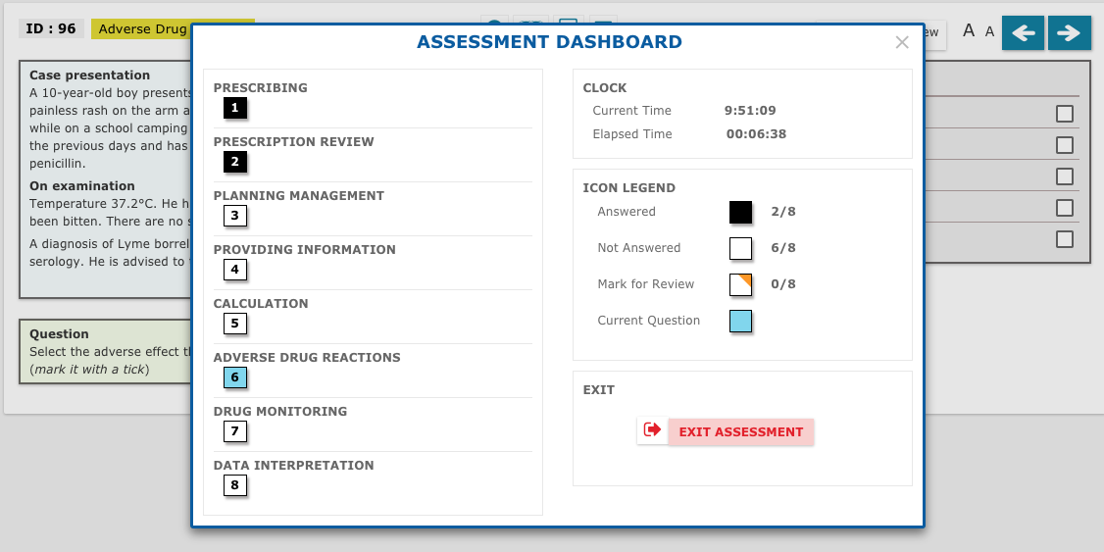

Slide 40
Guidance and Communication

Slide 41
Guidance and communications
Engaging with all medical schools on the development of national policies to guide the implementation
Running of assessment events
Retakes and remediation
Appeals
Candidates with disabilities
Development of appropriate contacts
Assessment and IT leads
Website development
https://beta.admin.prescribingsafetyassessment.ac.uk
Medical Schools
Medical Students
Other stakeholders

Slide 42
Feedback session
Thanks for time and interest
Key points of the day
What’s next
Evaluation forms
Expenses forms
Attendance forms

Slide 43
Programme
10.15 | Coffee and registration
10.30 | The Prescribing Safety Assessment – background, purpose and structure
10.50 | PSA Item styles (Prescribing, Prescription Review, Calculation skills)
11.50 | Coffee
12.00 | PSA Item styles (Providing Information, Adverse Drug Reaction, Planning Management, Drug Monitoring, Data Interpretation)
12.30 | The Prescribing Safety Assessment – quality control, peer review and delivery
12.45 | Lunch
13.15 | Breakout session in peer groups
15.45 | Feedback
16.00 | Close

